Slide 1
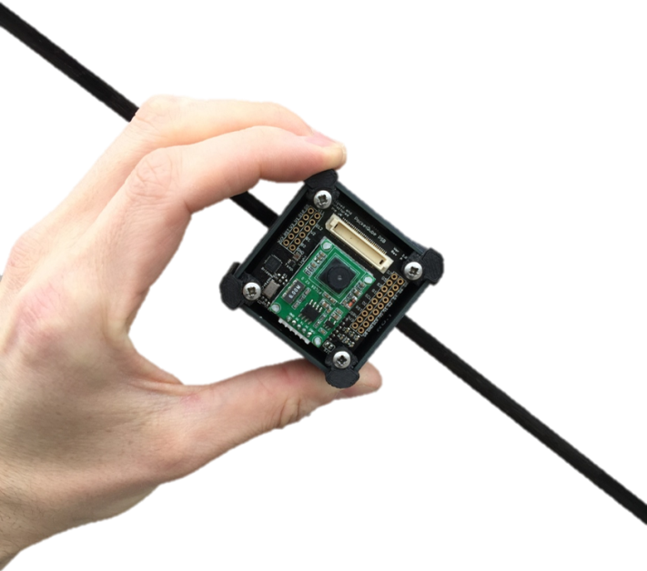

Pikoqube software overview
Sameer Rawal
ORION SPACE PVT. LTD.

Slide 2
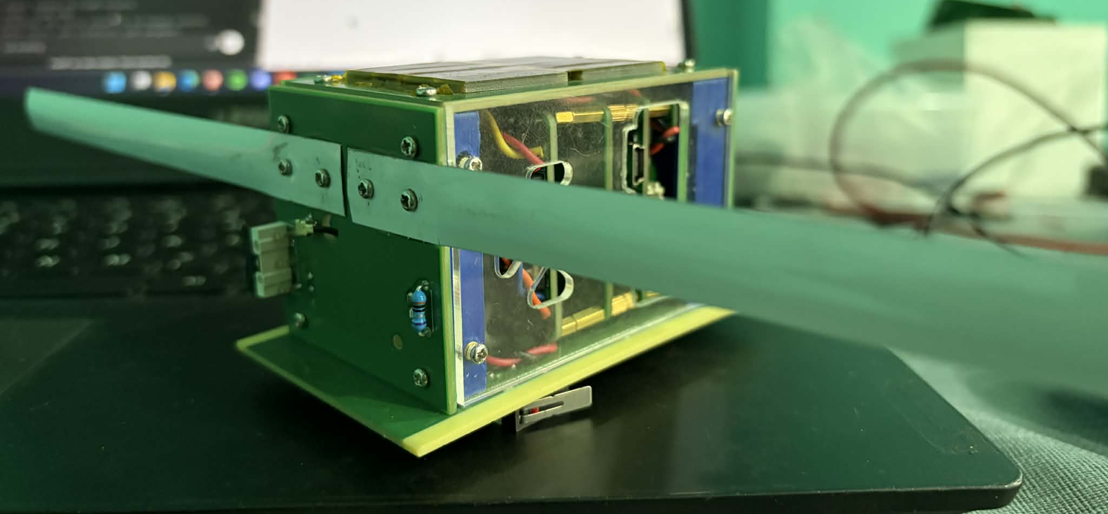
Pikoqube Software Overview
PikoQube Flight Software (FSW)
The Satellite's "Brain": Flight software is the onboard operating system that autonomously manages the satellite's health, coordinates sensor data, and executes ground commands without human intervention.
Autonomous Power Management: Dynamically switches between Normal, Low Power, and Critical modes based on battery voltage to prioritize mission survival.
Dual-Link Telemetry: Combines high-speed GFSK binary data for detailed science logging with ultra-resilient Morse Code beacons for emergency tracking.
Mission-Critical Fail-Safes: Features an external Watchdog timer and non-volatile FRAM memory to ensure the system recovers and retains data after radiation-induced reboots.

Slide 3
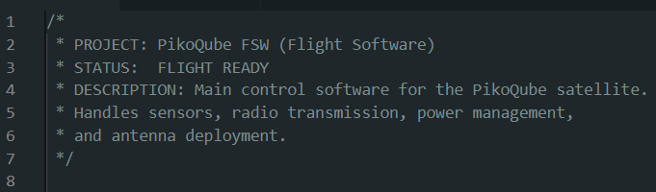
Pikoqube Software Overview
1. Short Intro
• Identifies the project as flight software • Describes overall responsibilities • Sets professional documentation style • Defines mission scope

Slide 4
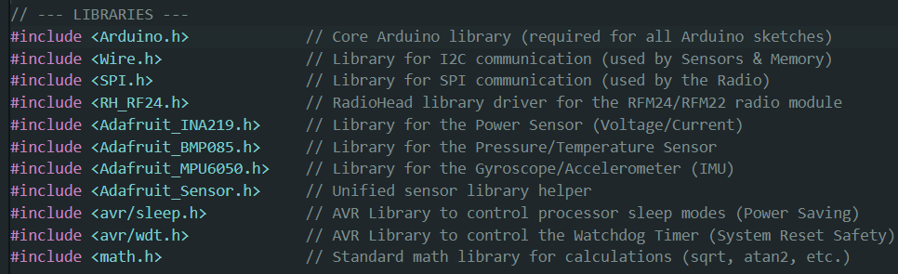
Pikoqube Software Overview
2. Libraries and Hardware Support
• Imports communication libraries (I2C, SPI, USART) • Imports sensor drivers • Imports radio driver • Imports low-power and watchdog support • Enables math and timing operations

Slide 5
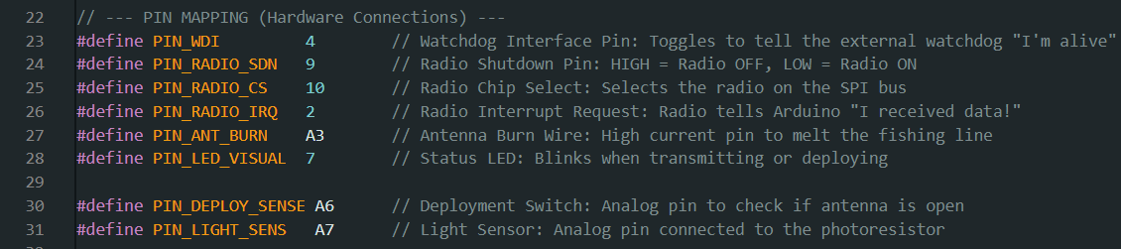
Pikoqube Software Overview
3. Pin Mapping (Hardware Interface Layer)
• Defines all electrical connections • Separates watchdog, radio, sensors, burn wire • Makes hardware changes easy • Acts as a hardware abstraction layer

Slide 6
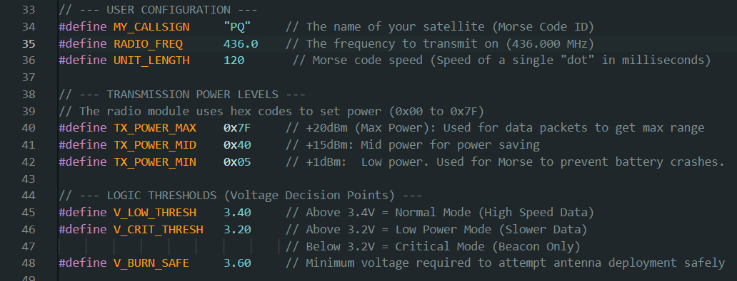
Pikoqube Software Overview
4. Mission Configuration and Thresholds
• Callsign and RF frequency • Morse timing • Transmission power levels • Battery decision thresholds • System timing behavior

Slide 7
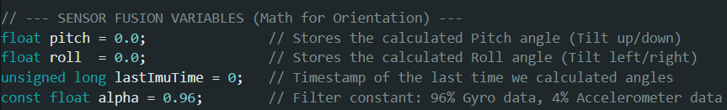
Pikoqube Software Overview
5. Orientation and Sensor Fusion Variables
• Stores satellite orientation • Time tracking for integration • Complementary filter constant • Supports real-time attitude estimation

Slide 8
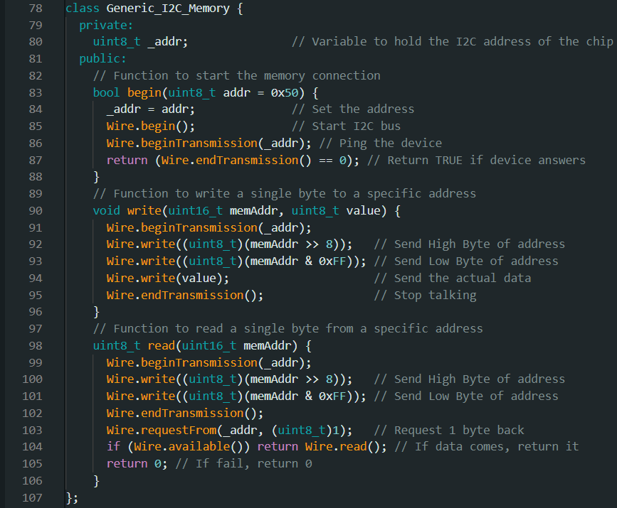
Pikoqube Software Overview
6. Custom FRAM Memory Driver
• Custom class for FRAM access • Abstracts I²C memory operations • Handles safe read/write • Enables persistent mission storage

Slide 9
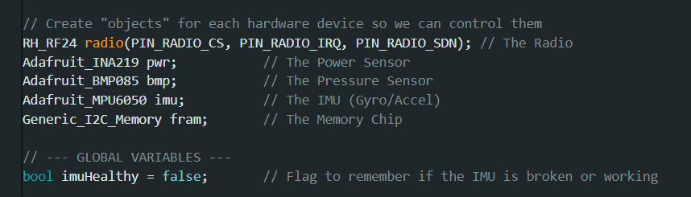
Pikoqube Software Overview
7. Hardware Objects and System State
• Creates device objects • Centralizes hardware control • Tracks sensor health

Slide 10
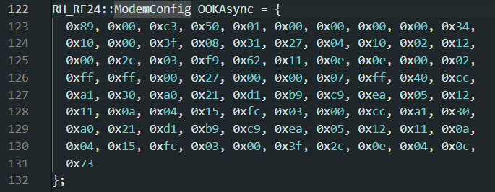
Pikoqube Software Overview
8. CW/OOK Configuration
• Raw register configuration • Enables on-off keying • Used for Morse beacon • Independent from packet modem

Slide 11
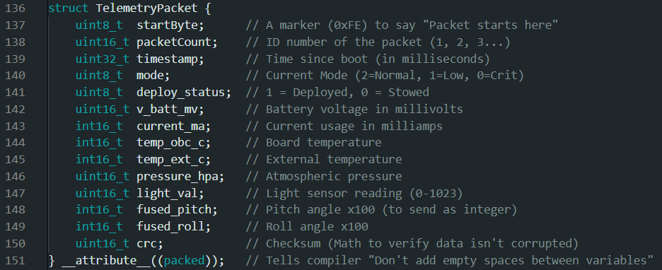
Pikoqube Software Overview
9. Telemetry Packet Definition
• Defines binary packet format • Optimized for RF transmission • Packed structure saves bandwidth • CRC protects data

Slide 12
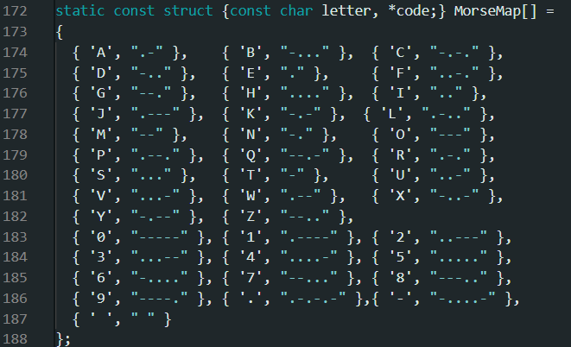
Pikoqube Software Overview
10. Morse Code Dictionary
• Lookup table for ASCII → Morse • Supports letters, numbers, symbols • Enables automatic CW generation

Slide 13
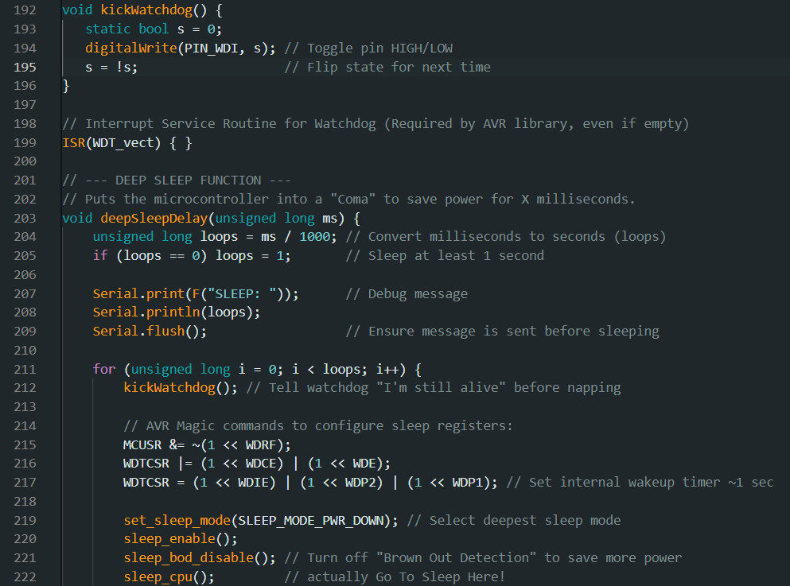
Pikoqube Software Overview
11. Watchdog and Deep Sleep System
• External watchdog heartbeat • Internal watchdog wakeup • Deep power-down sleep • Brown-out disabled • Autonomous survival design

Slide 14
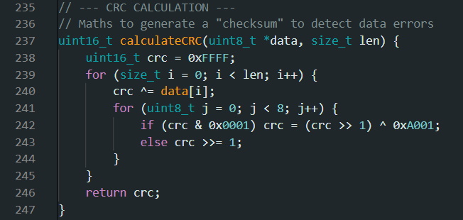
Pikoqube Software Overview
12. CRC Error Detection
• Detects corrupted packets • Standard CRC-16 algorithm • Protects telemetry integrity

Slide 15
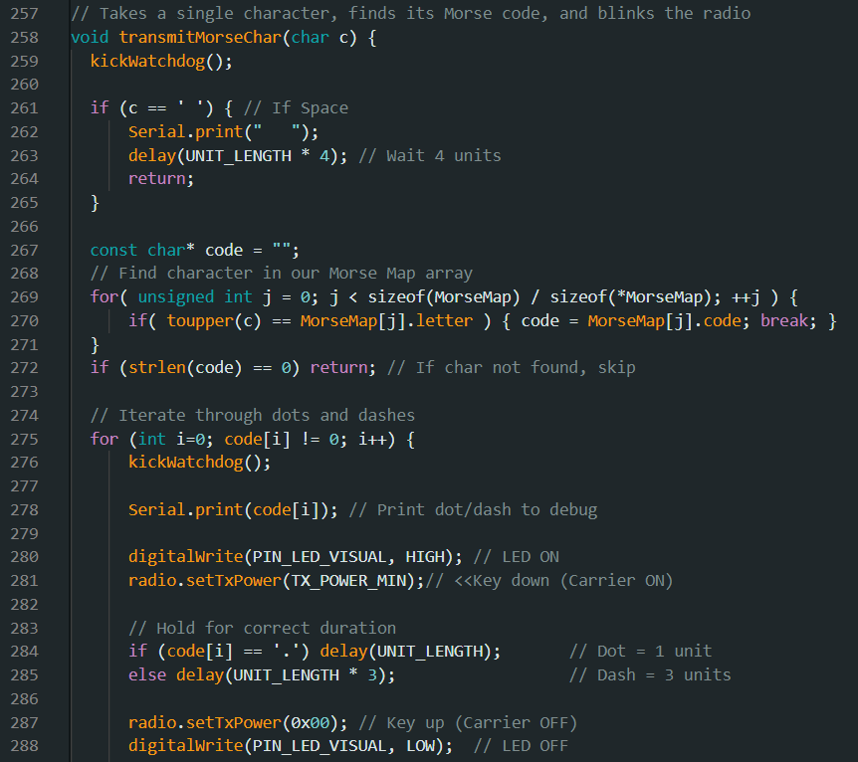
Pikoqube Software Overview
13. Morse Transmission Engine
• Converts characters to dots/dashes • Controls RF keying • Implements Morse timing rules • Low-power emergency beacon

Slide 16
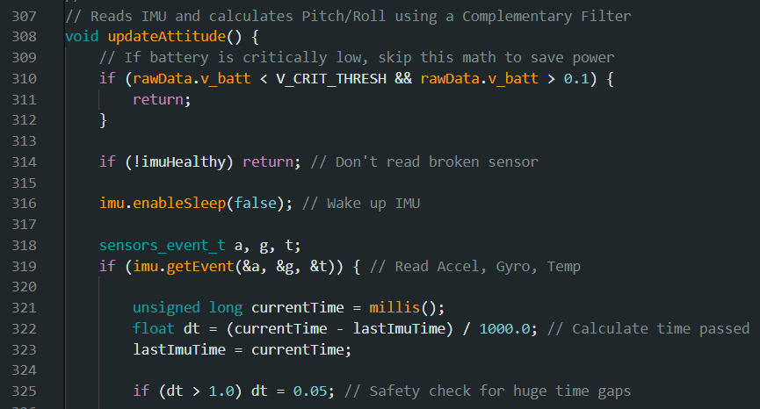
Pikoqube Software Overview
14. Sensor Fusion (Attitude Estimation)
• Accelerometer + gyroscope • Complementary filter • Low-power bypass logic • Pitch & roll estimation

Slide 17
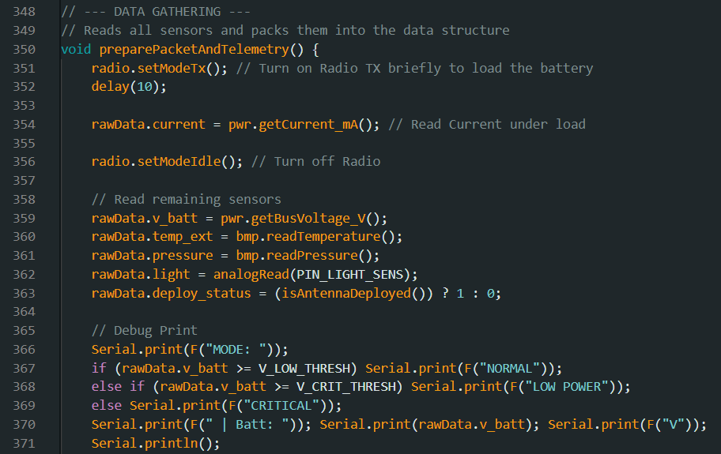
Pikoqube Software Overview
15. Telemetry Collection and Packet Builder
• Reads all sensors • Determines power mode • Scales floats to integers • Builds telemetry packet • Calculates CRC

Slide 18
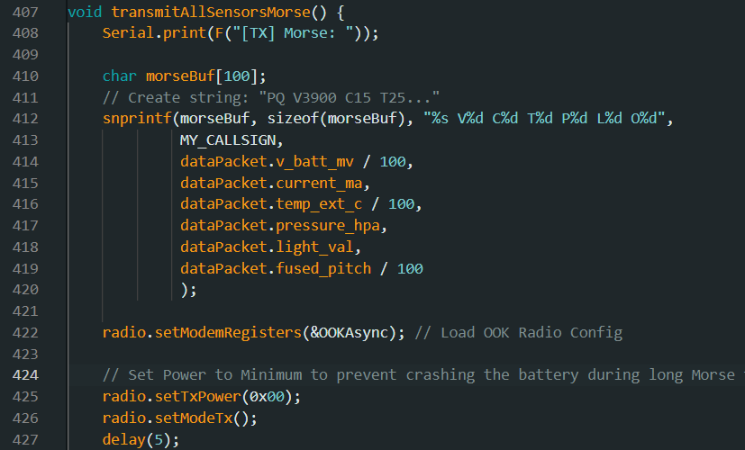
Pikoqube Software Overview
16. Morse Beacon
Format sensor data into text and transmit in morse

Slide 19
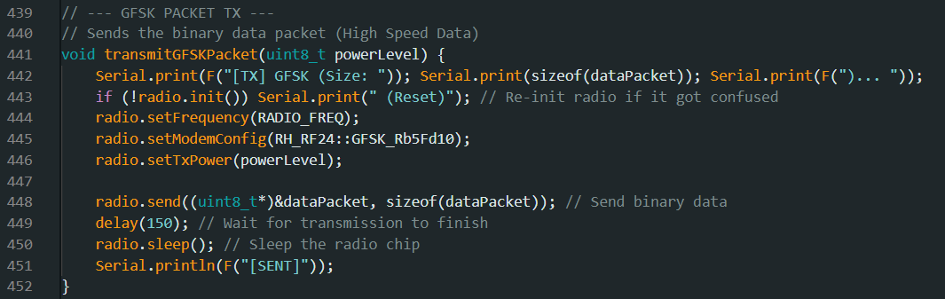
Pikoqube Software Overview
17. GFSK Telemetry Transmission
• High-speed telemetry • Packet-based communication • CRC protected • Power-controlled

Slide 20
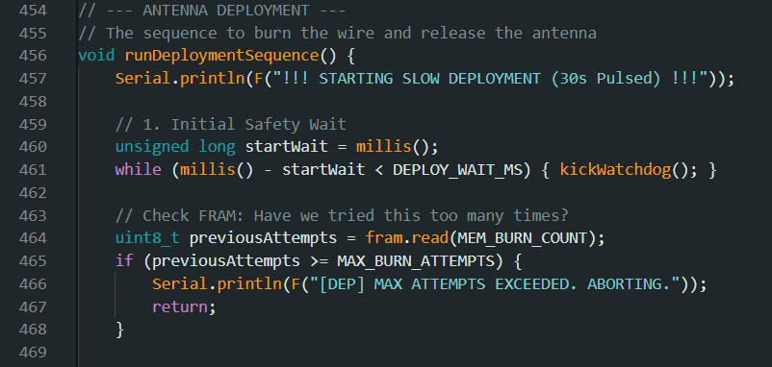
Pikoqube Software Overview
18. Antenna Deployment System
• FRAM-backed attempt counter • Pulsed burn wire heating • Automatic snap detection • Battery-safe deployment

Slide 21
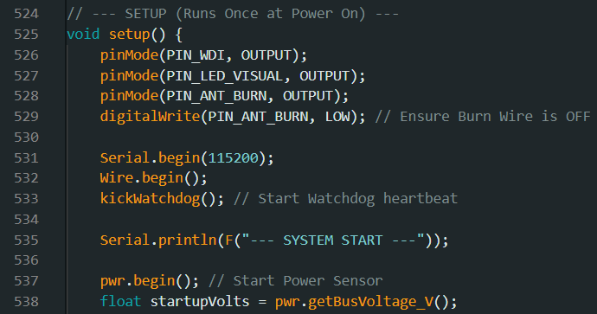
Pikoqube Software Overview
19. Setup Function (Boot Sequence)
• Initializes hardware • Checks sensors • Loads FRAM state • Runs deployment logic • Arms the satellite

Slide 22
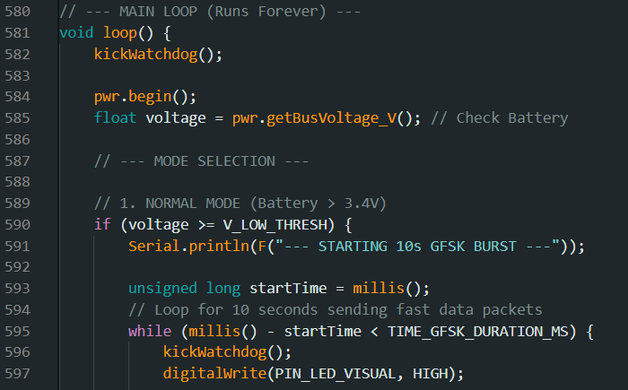
Pikoqube Software Overview
20. Main Control Loop (Autonomous Logic)
• Reads battery voltage • Selects power mode • Sends telemetry • Logs to FRAM • Sleeps

Slide 23
Pikoqube Software Overview
Why this Software is Flight-Grade
• Autonomous • Power-aware • Fault-tolerant • Redundant communication • Persistent memory • Real satellite architecture

Slide 24
THANK YOU!

